Slide 1

Web Application Term Project Presentation Air Pollution Monitoring & Prediction Web Page with GRU Model
Student ID: 201924426 Name: 김민재

Slide 2
Index
Introduction
Development process
Functions will be added

Slide 3
1. Introduction

Slide 4
Monitor global air condition and predict next day’s one!
1. Introduction
Showing global air condition and it’s details like CO2, AQI, ...
Predict the next day’s one using AI model

Slide 5
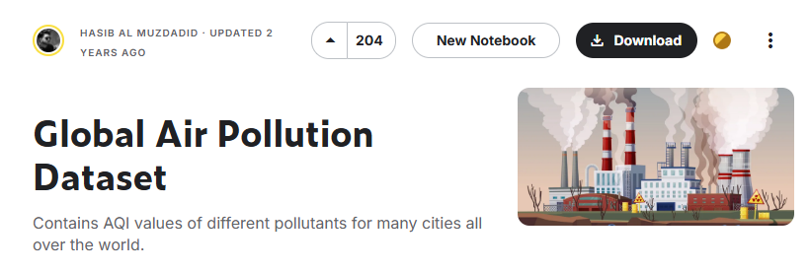
Air pollution Monitoring Service using open dataset
1. Introduction
1]
<Open Air Pollution dataset in kaggle>
- This dataset has only single air pollution value
- I pretend this shows daily air pollution metric
1] https://www.kaggle.com/datasets/hasibalmuzdadid/global-air-pollution-dataset?resource=download

Slide 6
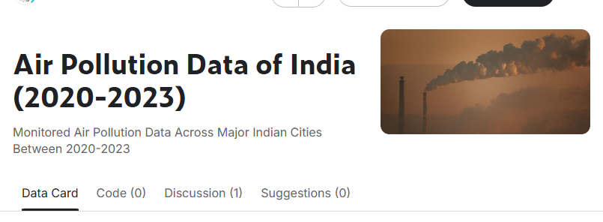
...and Predict future expected AQI score with GRU
1. Introduction
- It’s difficult to predict next day’s air condition with just singluar data.
- So, find out another dataset with time series.
2]
<Open Air Pollution dataset of India(2020-2023) in kaggle>
- Train this dataset with GRU and apply that model to website.
2] https://www.kaggle.com/datasets/seshupavan/air-pollution-data-of-india-2020-2023

Slide 7
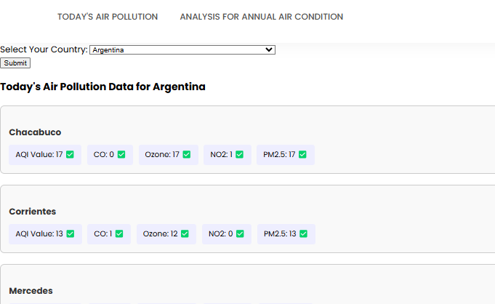
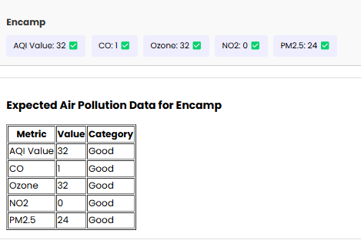
Web page with both monitoring and prediction
1. Introduction
<Monitoring>
<Prediction>

Slide 8
2. Development Process

Slide 9
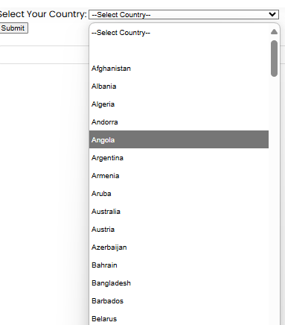
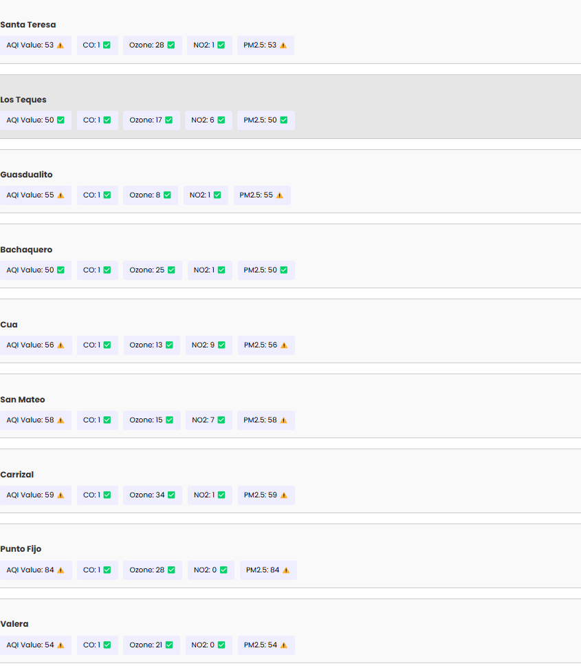
City Selection and Showing Details
2. Process
Loading CSV with jquery and make list of it of each cities of each countries
And marked the metrics with visual icon.
Some cities of china

Slide 10
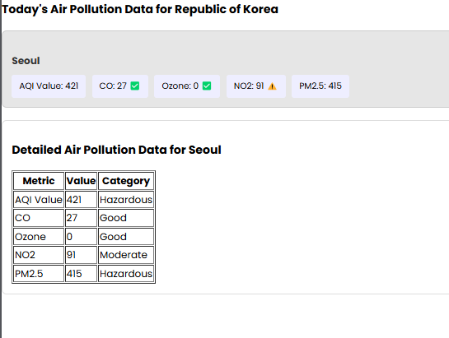
City Selection and Showing Details
2. Process
Clicking each city pops up the detail of each city.

Slide 11
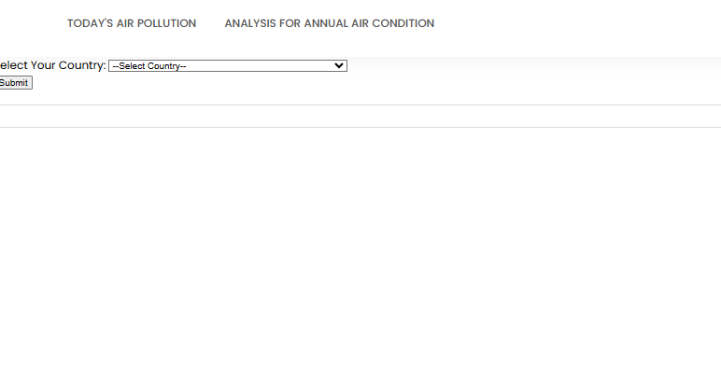
Page view for current version
2. Process

Slide 12
3. Functions will be added

Slide 13
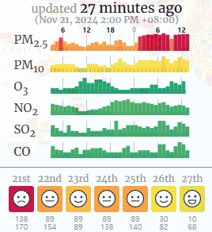

Air condition analysis of each city and prediction
3. Functions will be added
Visualization for specific period(week, month,...)
Using Tensorflow 2, will make the GRU based model
3]
3] https://waqi.info/

Slide 14
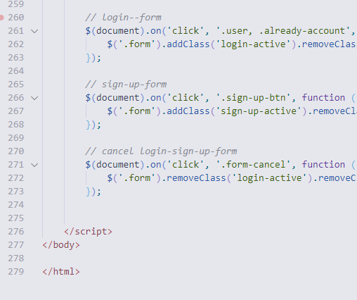
Refactoring codes for reusing and Designing
3. Functions will be added
For now, this index.html is too long. Using ajax and other files, I will separate these codes and make it with SPA.
And reference other pollution monitoring website, revise my design

Slide 15

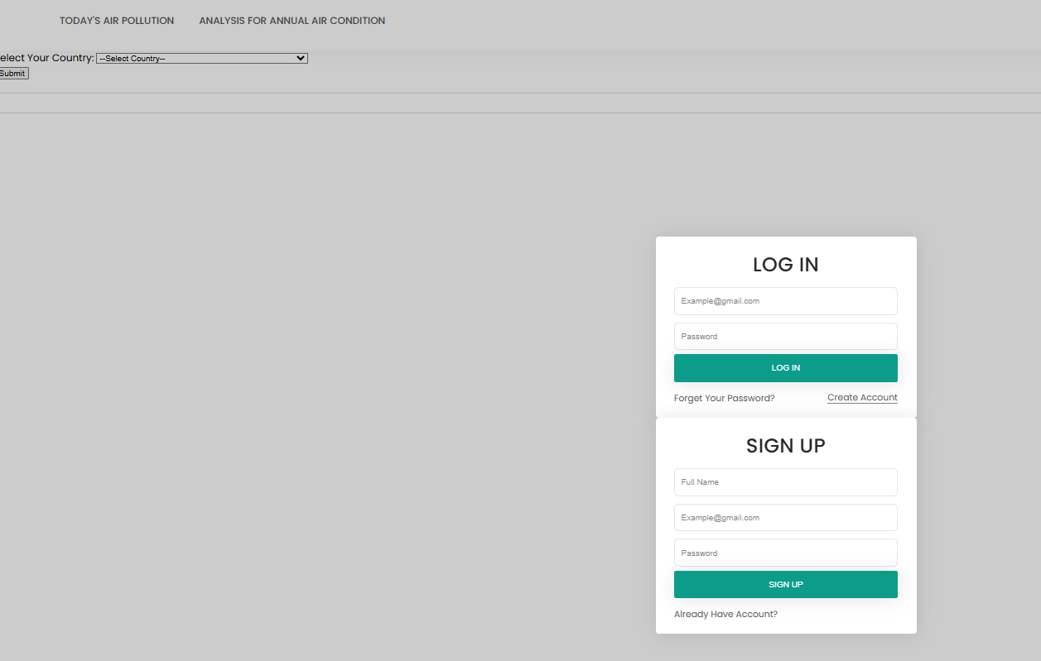
Adding login function and favorite regions
3. Functions will be added
Micro soft Edge’s favorite function
make list of favorite regions to fasten the search
and make it work to sign up and log in

Slide 16
https://chocomintlover.github.io/Air-Pollution-Monitoring-Web-Page/

